Slide 1
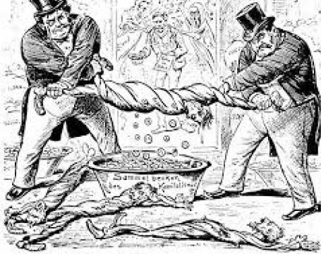
Karl Marx and Alienation

Slide 2
Social Inequality and social stratification
Inequality of conditions refers to the unequal distribution of material goods
Inequality of opportunities refers to the unequal distribution of life chances (access to education, health…)
Stratification system = “the complex of institutions that generate inequalities in income, political power, social honor, and other valued goods”. It has three components according to Grusky (2007):
the social processes that define certain types of goods as valuable and desirable,
the rules of allocation that distribute these goods across various roles or occupations in the division of labor […]
the mobility mechanisms that link individuals to these roles or occupations and thereby generate unequal control over valued goods

Slide 3
Theoretical Perspective on social class - Karl Marx
Karl Marx (1818-1883) was born in Prussia, on May 5, 1818.
His famous contribution are the Communist manifesto (1848) and volumes of Capital.
Marx’s theory of capitalism reflects on the forms of domination and forms of exploitation.
Capitalism as an economic system, or a particular “mode of production”
Characteristics of capitalism - social relations are constituted by labour and fundamentally different from those characteristics of the non-capitalistic society.

Slide 4
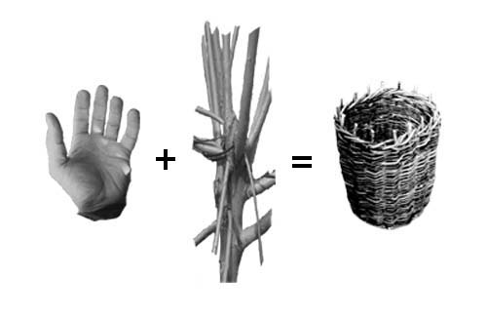
Theoretical Perspective on social class - Karl Marx
Capitalism characterizes society in terms of class relation structured by private ownership of the means of production and market regulated economy.
In any mode of production, the production of goods is based on two types of “productive forces”: means of production and labor force.

Slide 5
Theoretical Perspective on social class - Karl Marx
In the capitalist mode of production, the relations of production are organized as followed:
The means of production are owned by a small number of people who don’t need to work to earn a living : the bourgeoisie
All other people (the proletariat) must sell their labor force in order to earn a living

Slide 6
Karl Marx
Capitalist own and control production whereas proletariats with labour create wealth for the society.
Class opposition occurs because of the structural contradiction of capitalism – opposition between the dominating and the exploited.
The social wealth produced by the workers is appropriated by the capitalists for their individual/particularistic ends.
Capitalists employ workers (own labour time) and the means of production (tools and raw material).

Slide 7
Karl Marx
Marx offered structures of capitalism that cause alienation.
Alienation has four basic components:-
Productive activity – workers do not work for themselves but for the capitalists who pay them a subsistence wage in return. Both the worker and the capitalist believe that the payment of the wage means that the productive activity belongs to the capitalist.
Marx argued that productive activity in capitalism is reduced often to boring and stultifying means to fulfilment of the only end that is earning money to survive.
Productive activity belongs to the capitalists because they decide what is to be done with it and workers are alienated for that activity.

Slide 8
Karl Marx
Product – The workers are alienated not only from the productive activity but also from the object of those activities - product.
Marx argued the product of the labour does not belong to the workers, to be used by them in order to satisfy the basic needs.
The worker does not have control over the product. They lack detailed knowledge of aspects of production process.
Ex – Automobile assembly line workers and the end product car.
Here assembly lines are so long that many steps are involved and individuals are reduced to insignificant role in the whole process.

Slide 9
Karl Marx
Fellow workers – Marx assumes that people basically need and want to work co-operatively in order to appropriate from nature what they require to survive.
Marx argued that in capitalism this co-operation is disrupted and strangers are forced to work side by side for the capitalists. Even if workers are friends, the nature of technology makes for great deal of isolation.
Workers are also forced into outright competition and sometimes conflict with one another. The reward system, pitting one against the other generates considerable hostility among workers towards their peers.

Slide 10
Karl Marx
From their own human potential/himself – Marx assumes that individuals perform less and less like human beings as they are reduced in their work to animals, beasts or inhumane machines.
In capitalism according to Marx the natural interrelationship between the head and the hand is broken so that only a few people are allowed to do the head work and most others do the handwork that is devoid of the mental component.
Sources of alienation –
Structures in the modern workplace that subdivided labour into narrower and narrower specialities.

Slide 11
Karl Marx
Sources of alienation –
Those structures in the modern workplace that limit the amount of control workers exercise over the work they do.
Alienation carries with it the assumption that the dignity of the workers can not be maintained unless the work process allows autonomy, responsibility and self-fulfilment.
The feeling of powerlessness, isolation and self-estrangement – alienation of the worker.

Slide 12
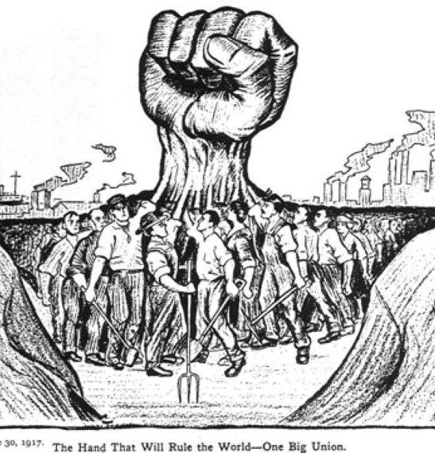
Communism
Marx drops the term democracy in favour of ‘communism’. For him overcoming of alienation hinges on the supersession of private property
Acc. to him what is most essential is reorganisation of society based upon eradication of the then existing relation between private property and wage-labour
Revolution as a means of achieving communist state.

Slide 13
Communist society and Marx
Communist society, as envisioned by Marx, was going to be characterized by unprecedented material abundance, the “withering away” of the state (that is to say, the state as an agent of coercion), and the disappearance of all inequalities and social problems (or social pathologies) such as crime, alcoholism, and family disintegration
Most importantly, exploitation and alienation were going to be eliminated
Under these conditions, the conflict between individual and society, or private and public interests, was also supposed to disappear

Slide 14
Communist States
Some of the communist states were totalitarian—at least during certain periods, such as the Soviet Union under Stalin, China under Mao Tse-tung, Cambodia under Pol Pot, and Cuba under Fidel Castro
Totalitarian states unlike other repressive, authoritarian systems, developed unusually efficient and ambitious methods of social control and intimidation and sought to politicize most spheres of life
In the totalitarian society, the party/state reserved the right to interfere in aspects of life that used to be matters of indifference for other authoritarian rulers (i.e., the family, sexual morality, recreation, sports, travel, etc.)

Slide 15
Communist States
These totalitarian systems controlled both the means of production and mass communication
It is indisputable, however, that in 1991 the Soviet Union fell apart. It is also indisputable that between 1989 and 1991, communist systems in Eastern Europe imploded
Those Eastern European regimes collapsed when it became clear that the Soviet Union under Mikhail Gorbachev would not keep them in power by Soviet military force as it had done in 1953 in East Germany, in 1956 in Hungary, and in 1968 in Czechoslovakia

Slide 16
Communist System
The collapse of Soviet communism also helped to hasten the end of the communist systems in Ethiopia and Nicaragua and weakened communist movements in other parts of the world
It has also stimulated the change of economic policies in some of the surviving communist states, especially China and Vietnam. Economic policies in Cuba and North Korea, however, remain largely unchanged
The failure of communism to meet the material needs of the populace became more obvious over time. Shortages of even the most basic foodstuffs and consumer goods were chronic and ubiquitous throughout the communist bloc, especially the Soviet Union

Slide 17
Communist System
Communist leaders shared Marx’s conviction that capitalism and the profit motive were the sources of all evil.
They also believed that religion was a primitive and debilitating superstition and a tool of the ruling classes that had to be suppressed.
Marx and the leaders of actually existing communist systems also shared a contempt for peasants and their traditions.
Marx’s doctrine of class struggle too was eagerly embraced by communist leaders and helped to legitimize their ruthlessness and intolerance for any opposition or dissent.
Neither Marx nor 20th-century communist leaders were concerned with the dangers of bureaucratization and the concentration of political power

Slide 18
Communist system
The disunity between theory and practice was more apparent.
The public ownership of the means of production did not make the economy more productive
The workers deprived of autonomous trade unions had less control over their wages and working conditions than their counterparts under capitalism; they were often searched when exiting the factories (to make sure they did not steal) and had little reason to consider themselves masters of their fate and owners of the means of production
One-party rule was no more democratic than parliamentary democracy

Slide 19
Communist System
The Communist Party was not composed of the most selfless and idealistic representatives of the working classes; the leaders of the party and government proved quite vulnerable to corruption
Communist prisons were no more humane than those in capitalist countries and they too failed to rehabilitate the inmates
The privileges of the nomenklatura (system whereby influential posts were filled by Party appointees) contradicted the ideals of social equality.
The masses did not readily accept that religion was their opiate and that the persecution of believers was just and served a useful purpose.

Slide 20
Karl Marx Theory of Surplus Value
Capitalism according to Marx – emphasises on the system of commodity production.
Capitalist system producers simply do not produce for their own needs or for the need of the individual with whom they are in personal contact.
Capitalism involves nation-wide and often international exchange market.
Every commodity has two fold aspect according to Marx:-
Use value – which is realised in the process of consumption.
Ex- Cars have use value – transport or Food have use value – satisfying hunger.
Exchange value - value a product has when offered in exchange for other products.
Ex- Car exchange value for chairs. Car has more exchange value than chair as for its production machines, factory, labour, etc. is required whereas for producing chair labour, machinery required is comparatively less. (However, this is not fixed)

Slide 21
Karl Marx Theory of Surplus Value
An object can have use-value whether or not it is a commodity but a commodity or a product must have use-value.
Ex- If a person grows vegetables on his farm and uses them then it has use value but is not a commodity. When we go to the market and buy vegetables then it is a commodity.
Exchange value - It presupposes a definite economic relation and is inseparable from the market on which good are exchanged.
Labor theory of value –
Both use-value and exchange-value must be directly related to the amount of labour embodied in the production of a commodity.

Slide 22
Karl Marx Theory of Surplus Value
Labor theory of value –
Exchange-value can not be derived from use-value.
Ex- Deciding the exchange value of corn and iron. For some corn might be important and for some iron so use-value is not the right indicator of exchange-value. Here exchange value will rest upon some quantified characteristics of labour.
Capitalists are not interested in the use-value of a good but in the exchange-value which is produced by labour (concrete labour).

Slide 23
Karl Marx Theory of Surplus Value
Labour process time –
L X P = Wealth; (L- Labour process, P- its productivity)
Production = Wealth/Labour
Forces of production-
Capitalism produces forces of production. To produce more wealth the relation of labour will be more complex.
Ex- Necessary labour needed for food production + Surplus labour = Total Labour (food produced)
Forces of production + relation of production = Mode of production.

Slide 24
Karl Marx Theory of Surplus Value
Mode of production – comprises of both relation of production and forces of production.
Abstract labour – is an historical category. It is the socially necessary labour time. Productivity will increase the wealth but in that case the socially necessary labour time will fall.
Ex- Productive labour will be productive of surplus value whereas unproductive labour will not be productive with surplus value.

Slide 25
Karl Marx Theory of Surplus Value
Rate of surplus value = rate of exploitation.
Surplus value is the source of profit.

